Slide 1
Data-intensive Computing Systems
How MapReduce Works (in Hadoop)
Shivnath Babu

Slide 2
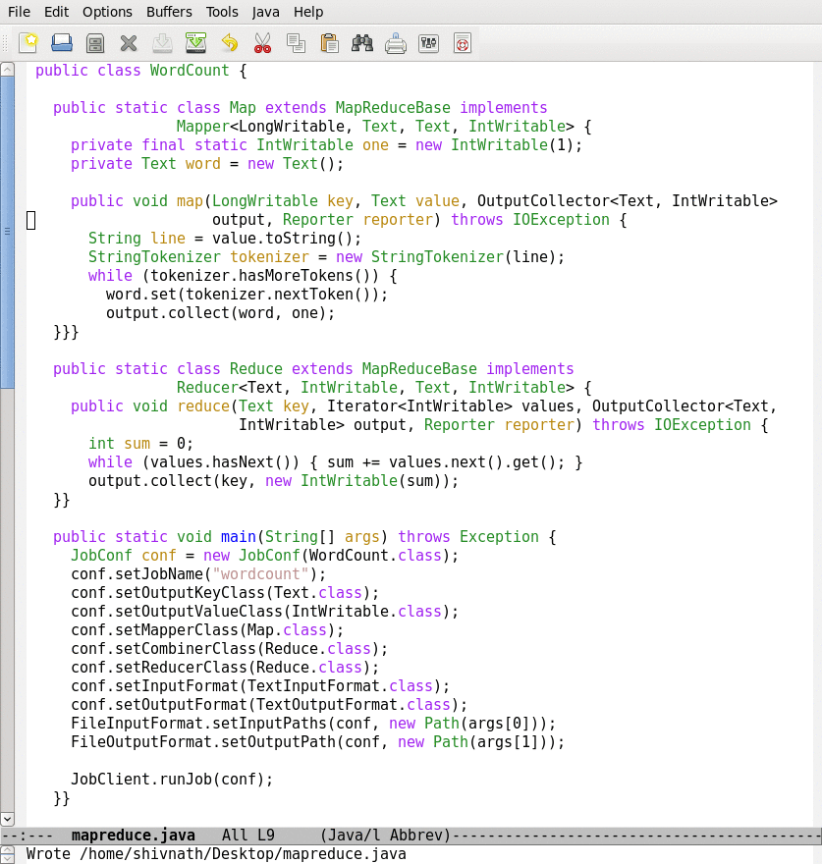
Lifecycle of a MapReduce Job
Map function
Reduce function
Run this program as a
MapReduce job

Slide 3
Lifecycle of a MapReduce Job
Map function
Reduce function
Run this program as a
MapReduce job

Slide 4
Lifecycle of a MapReduce Job
Time
Input
Splits
Map
Wave 1
Map
Wave 2
Reduce
Wave 1
Reduce
Wave 2
Notes:
Industry wide it is recognized that to manage the complexity of today’s systems, we need to make systems self-managing. IBM’s autonomic computing, Microsoft’s DSI, and Intel’s proactive computing are some of the major efforts in this direction.

Slide 5
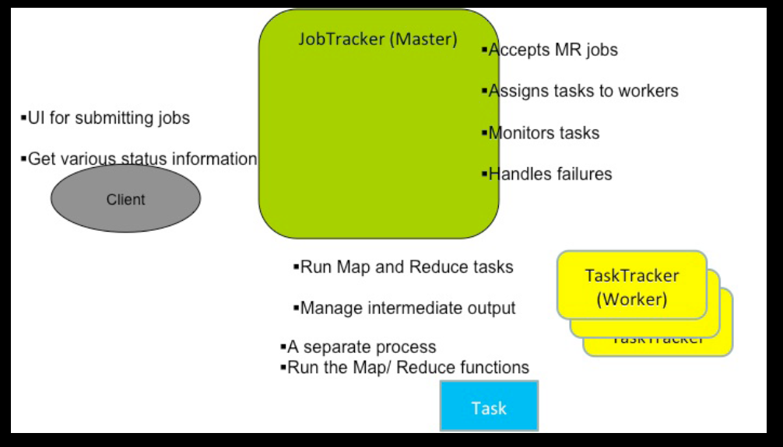
Components in a Hadoop MR Workflow
Next few slides are from: http://www.slideshare.net/hadoop/practical-problem-solving-with-apache-hadoop-pig

Slide 6
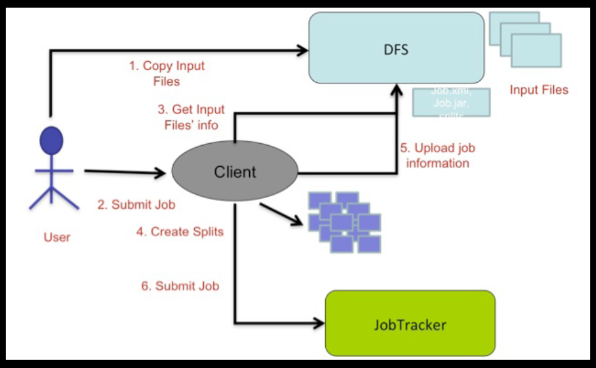
Job Submission

Slide 7
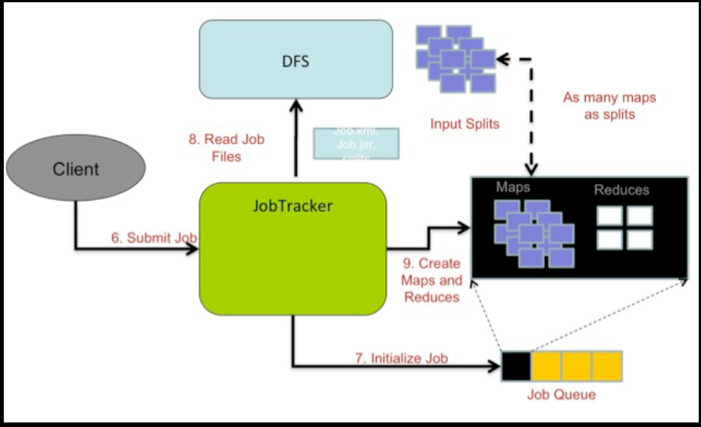
Initialization

Slide 8
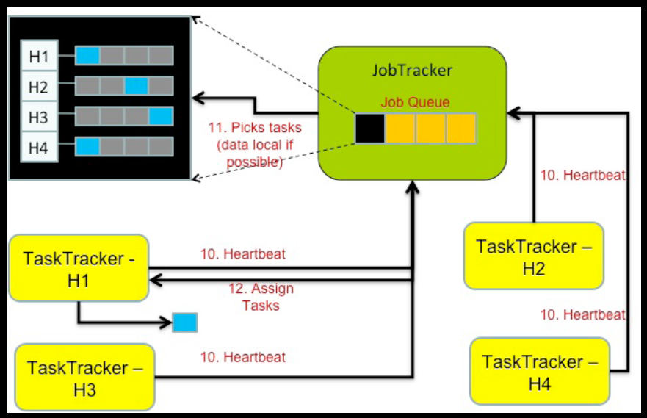
Scheduling

Slide 9
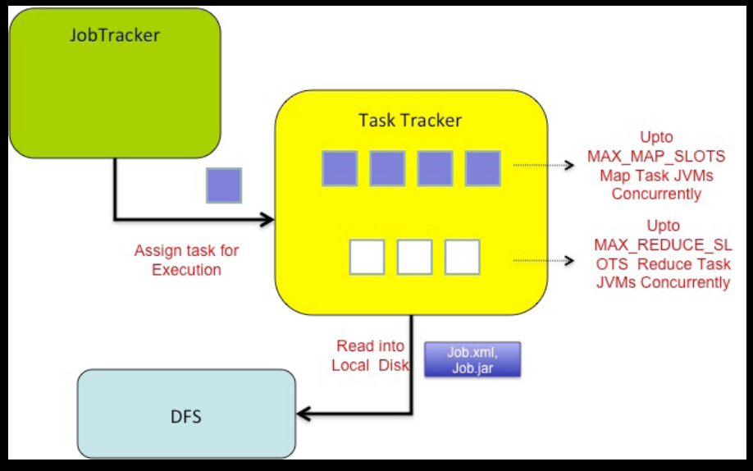
Execution

Slide 10
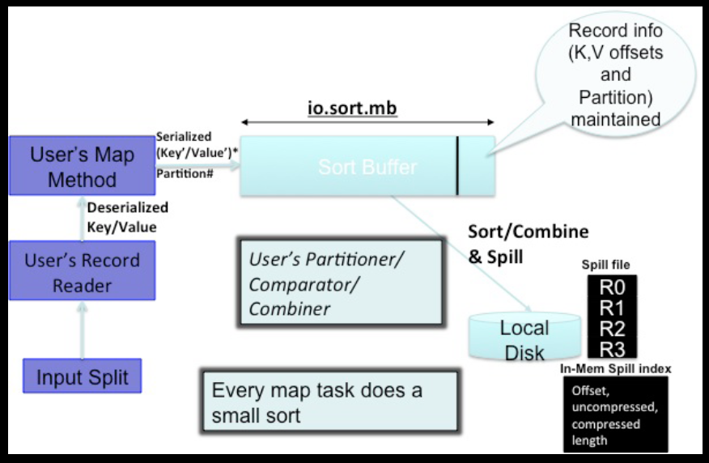
Map Task

Slide 11
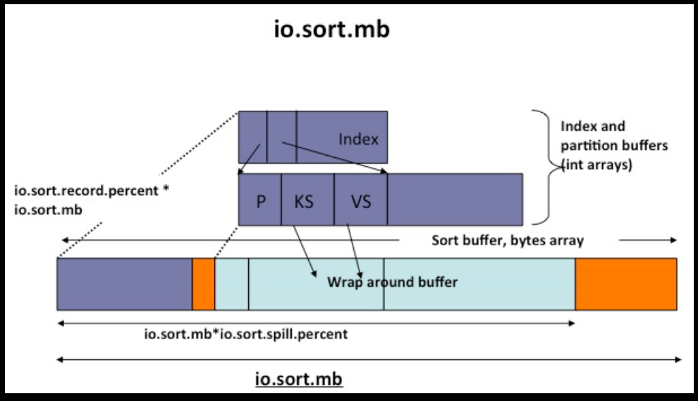
Sort Buffer

Slide 12
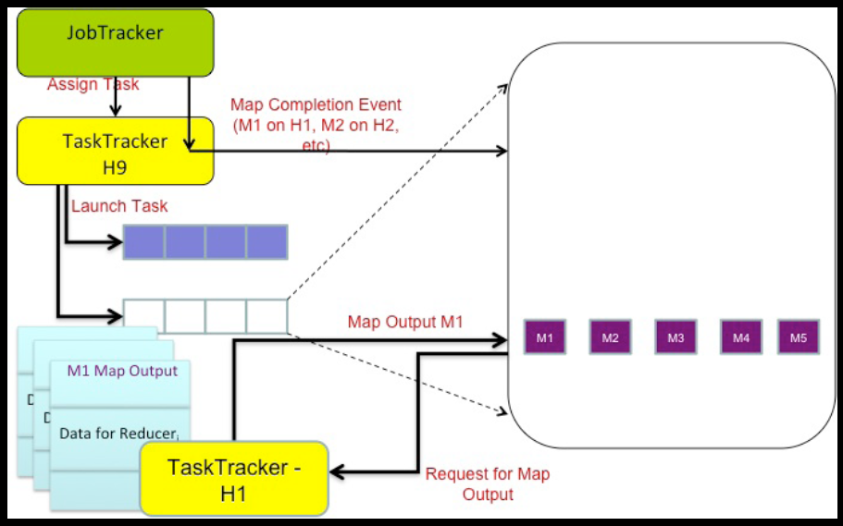
Reduce Tasks

Slide 13
Quick Overview of Other Topics (Will Revisit Them Later in the Course)
Dealing with failures
Hadoop Distributed FileSystem (HDFS)
Optimizing a MapReduce job

Slide 14
Dealing with Failures and Slow Tasks
What to do when a task fails?
  Try again (retries possible because of idempotence)
  Try again somewhere else
  Report failure
What about slow tasks: stragglers
  Run another version of the same task in parallel. Take results from the one that finishes first
  What are the pros and cons of this approach?
Fault tolerance is of
high priority in the
MapReduce framework

Slide 15
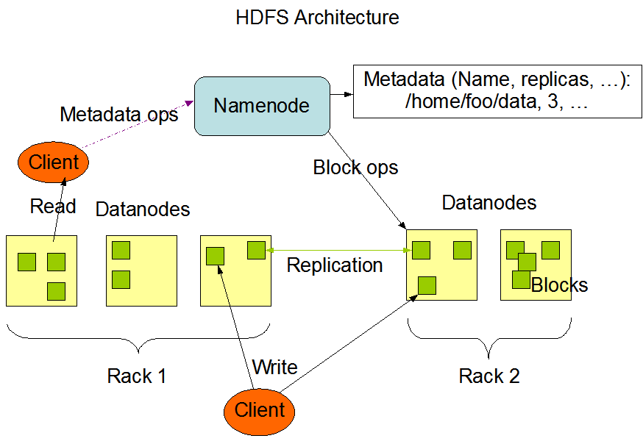
HDFS Architecture

Slide 16
Lifecycle of a MapReduce Job
Time
Input
Splits
Map
Wave 1
Map
Wave 2
Reduce
Wave 1
Reduce
Wave 2
How are the number of splits, number of map and reduce
tasks, memory allocation to tasks, etc., determined?
Notes:
Industry wide it is recognized that to manage the complexity of today’s systems, we need to make systems self-managing. IBM’s autonomic computing, Microsoft’s DSI, and Intel’s proactive computing are some of the major efforts in this direction.

Slide 17
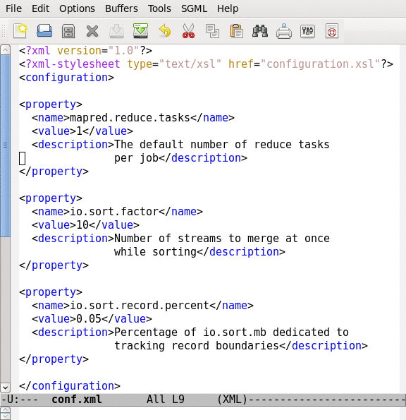
Job Configuration Parameters
190+ parameters in Hadoop
Set manually or defaults are used

Slide 18
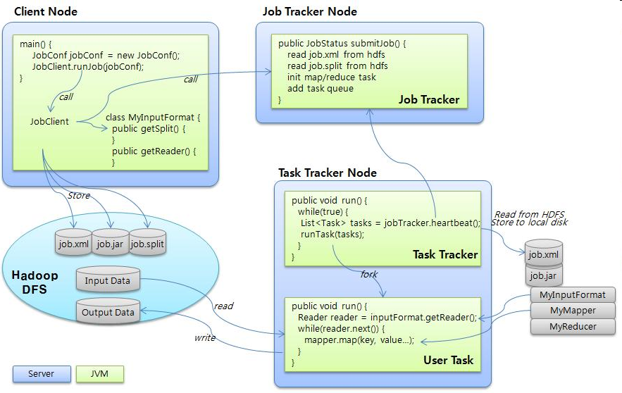
Hadoop Job Configuration Parameters
Image source: http://www.jaso.co.kr/265
Notes:
Industry wide it is recognized that to manage the complexity of today’s systems, we need to make systems self-managing. IBM’s autonomic computing, Microsoft’s DSI, and Intel’s proactive computing are some of the major efforts in this direction.

Slide 19
Tuning Hadoop Job Conf. Parameters
Do their settings impact performance?
What are ways to set these parameters?
  Defaults -- are they good enough?
  Best practices -- the best setting can depend on data, job, and cluster properties
  Automatic setting
Notes:
Industry wide it is recognized that to manage the complexity of today’s systems, we need to make systems self-managing. IBM’s autonomic computing, Microsoft’s DSI, and Intel’s proactive computing are some of the major efforts in this direction.

Slide 20
Experimental Setting
Hadoop cluster on 1 master + 16 workers
Each node:
  2GHz AMD processor, 1.8GB RAM, 30GB local disk
  Relatively ill-provisioned!
  Xen VM running Debian Linux
  Max 4 concurrent maps & 2 reduces
    Maximum map wave size = 16x4 = 64
    Maximum reduce wave size = 16x2 = 32
Not all users can run large Hadoop clusters:
  Can Hadoop be made competitive in the 10-25 node, multi GB to TB data size range?
Notes:
Industry wide it is recognized that to manage the complexity of today’s systems, we need to make systems self-managing. IBM’s autonomic computing, Microsoft’s DSI, and Intel’s proactive computing are some of the major efforts in this direction.

Slide 21
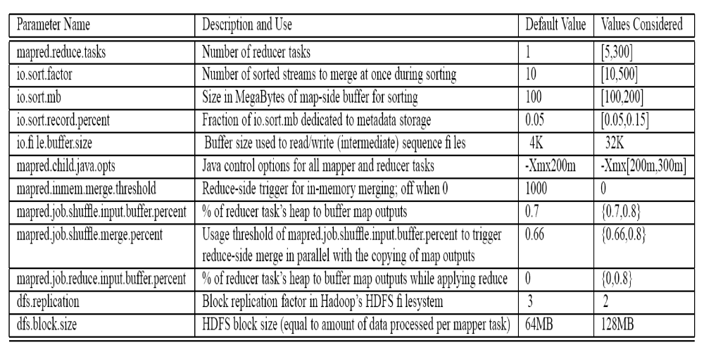
Parameters Varied in Experiments
Notes:
Industry wide it is recognized that to manage the complexity of today’s systems, we need to make systems self-managing. IBM’s autonomic computing, Microsoft’s DSI, and Intel’s proactive computing are some of the major efforts in this direction.

Slide 22
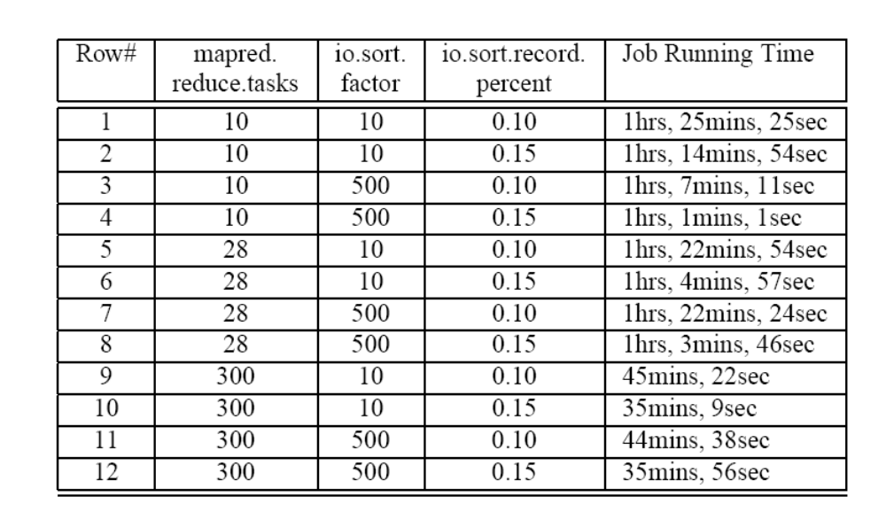
Hadoop 50GB TeraSort
Varying number of reduce tasks, number of concurrent sorted streams for merging, and fraction of map-side sort buffer devoted to metadata storage
Notes:
Industry wide it is recognized that to manage the complexity of today’s systems, we need to make systems self-managing. IBM’s autonomic computing, Microsoft’s DSI, and Intel’s proactive computing are some of the major efforts in this direction.

Slide 23
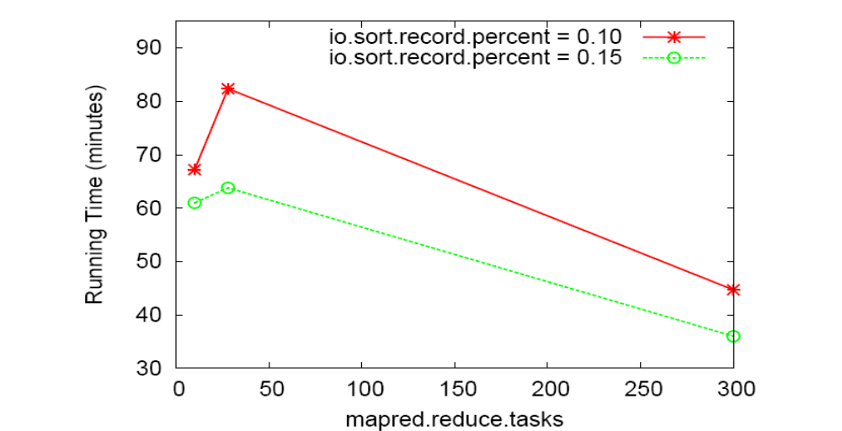
Hadoop 50GB TeraSort
Varying number of reduce tasks for different values of the fraction of map-side sort buffer devoted to metadata storage (with io.sort.factor = 500)
Notes:
Industry wide it is recognized that to manage the complexity of today’s systems, we need to make systems self-managing. IBM’s autonomic computing, Microsoft’s DSI, and Intel’s proactive computing are some of the major efforts in this direction.

Slide 24
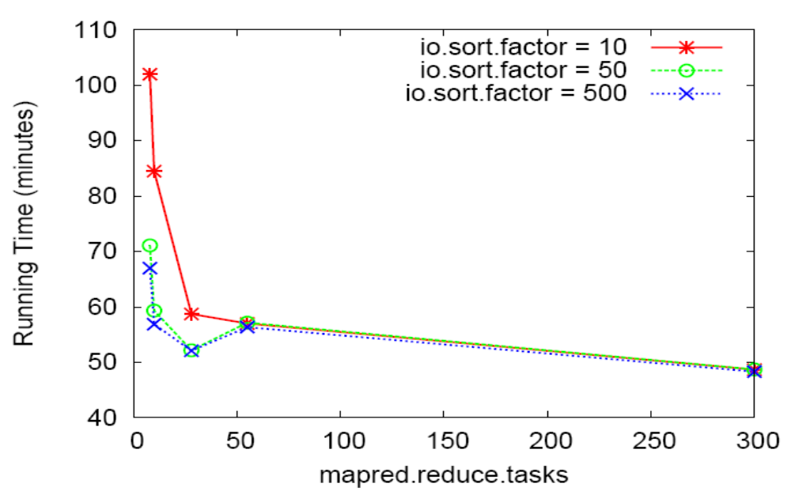
Hadoop 50GB TeraSort
Varying number of reduce tasks for different values of io.sort.factor (io.sort.record.percent = 0.05, default)
Notes:
Industry wide it is recognized that to manage the complexity of today’s systems, we need to make systems self-managing. IBM’s autonomic computing, Microsoft’s DSI, and Intel’s proactive computing are some of the major efforts in this direction.

Slide 25
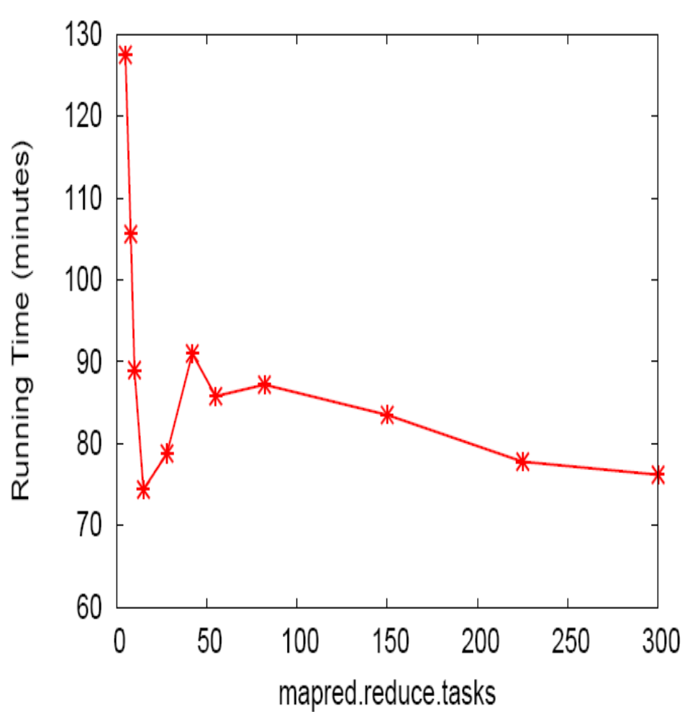
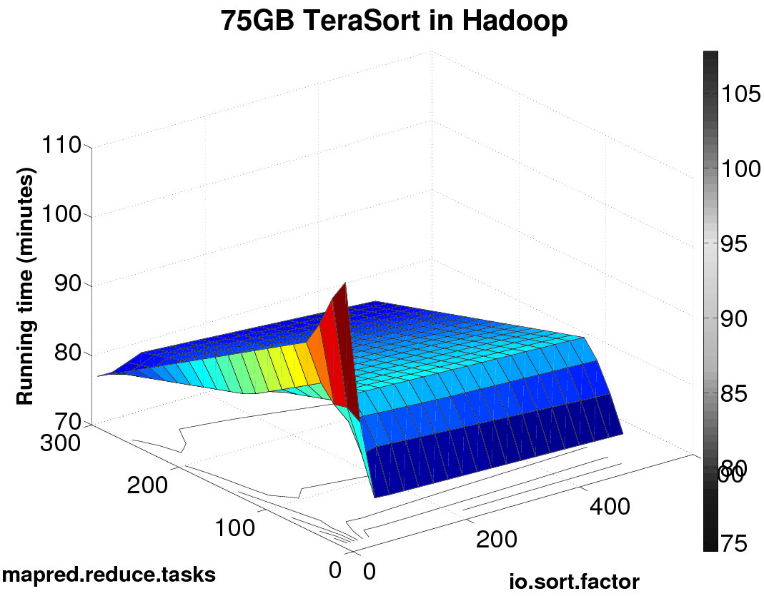
Hadoop 75GB TeraSort
1D projection for io.sort.factor=500
Notes:
Industry wide it is recognized that to manage the complexity of today’s systems, we need to make systems self-managing. IBM’s autonomic computing, Microsoft’s DSI, and Intel’s proactive computing are some of the major efforts in this direction.

Slide 26
Automatic Optimization? (Not yet in Hadoop)
Shuffle
Map
Wave 1
Map
Wave 2
Map
Wave 3
Reduce
Wave 1
Reduce
Wave 2
What if
#reduces
increased
to 9?
Map
Wave 1
Map
Wave 2
Map
Wave 3
Reduce
Wave 1
Reduce
Wave 2
Reduce
Wave 3
Notes:
Industry wide it is recognized that to manage the complexity of today’s systems, we need to make systems self-managing. IBM’s autonomic computing, Microsoft’s DSI, and Intel’s proactive computing are some of the major efforts in this direction.

